Slide 1
Building Science
Joseph Lstiburek, Ph.D., P.Eng, ASHRAE Fellow
There’s No Such Thing As A Free Thermodynamic Lunch
www.buildingscience.com

Slide 2
Some Physics….

Slide 3
Arrhenius Equation

Slide 4
For Every 10 Degree K Rise
Reaction Rate Doubles

Slide 5
Damage Functions
Water
Heat
Ultra-violet Radiation

Slide 6
Damage Functions
Water
Heat
Ultra Violet Radiation
Oxidization (Ozone)
Fatigue (Creep)

Slide 7
The Three Biggest Problems In Buildings Are Water, Water and Water…

Slide 8
Laws of Thermodynamics

Slide 9
Zeroth Law – Equal Systems
First Law - Conservation of Energy
Second Law - Entropy
Third Law – Absolute Zero

Slide 10
2nd Law of Thermodynamics

Slide 11
In an isolated system, a process can occur only if it increases the total entropy of the system
Rudolf Clausius

Slide 12
Heat Flow Is From Warm To Cold
Moisture Flow Is From Warm To Cold
Moisture Flow Is From More To Less
Air Flow Is From A Higher Pressure to a Lower Pressure
Gravity Acts Down

Slide 13
Moisture Flow Is From Warm To Cold
Moisture Flow Is From More To Less

Slide 14
Moisture Flow Is From Warm To Cold
Moisture Flow Is From More To Less
Thermal Gradient – Thermal Diffusion
Concentration Gradient – Molecular Diffusion

Slide 15
Moisture Flow Is From Warm To Cold
Moisture Flow Is From More To Less
Thermal Gradient – Thermal Diffusion
Concentration Gradient – Molecular Diffusion
Vapor Diffusion

Slide 16
Thermodynamic Potential

Slide 17
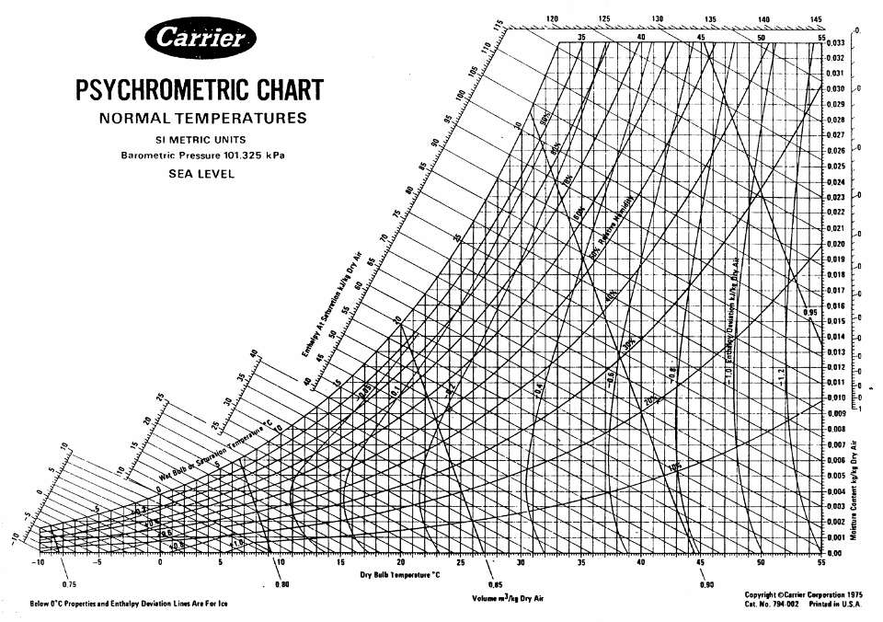

Slide 18
Energy Flow

Slide 24
Materials

Slide 25
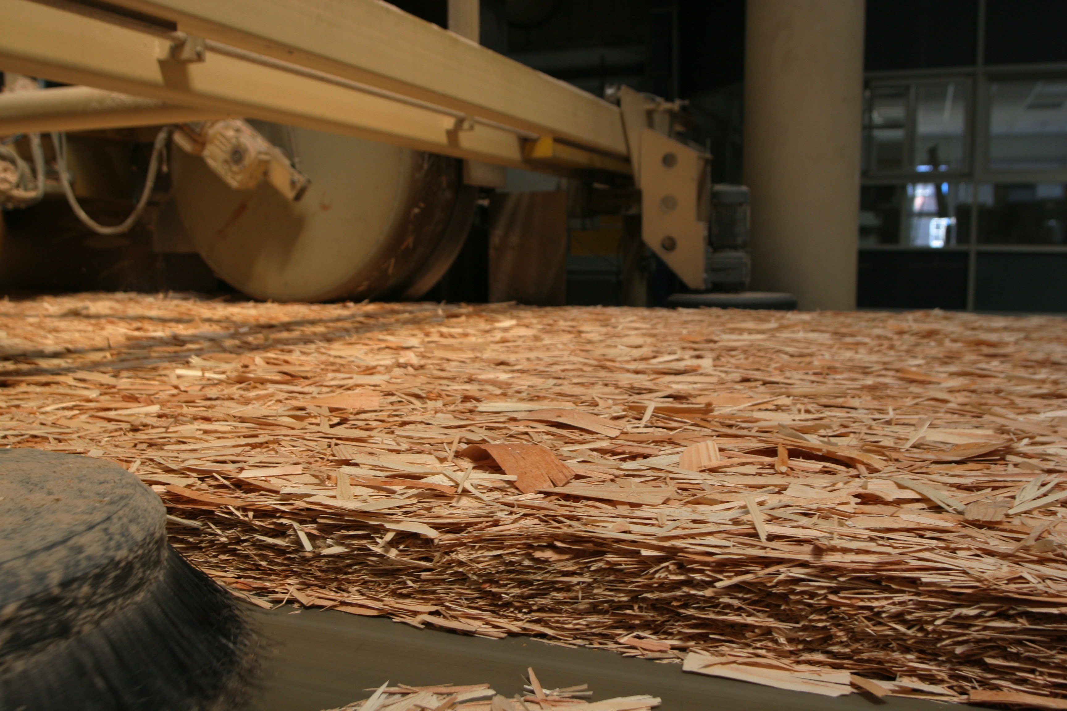

Slide 26
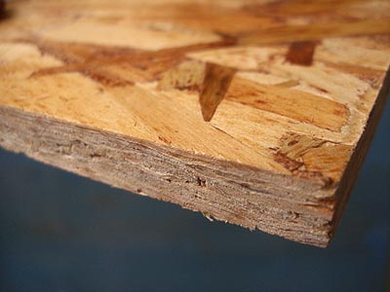

Slide 27
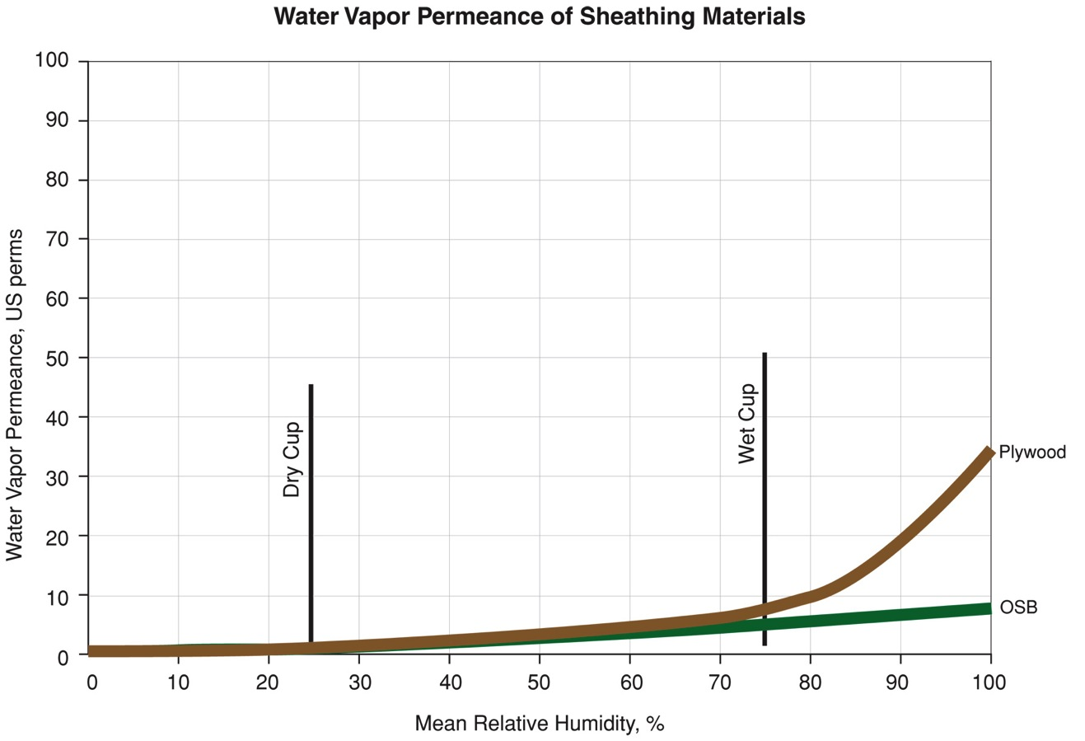

Slide 28
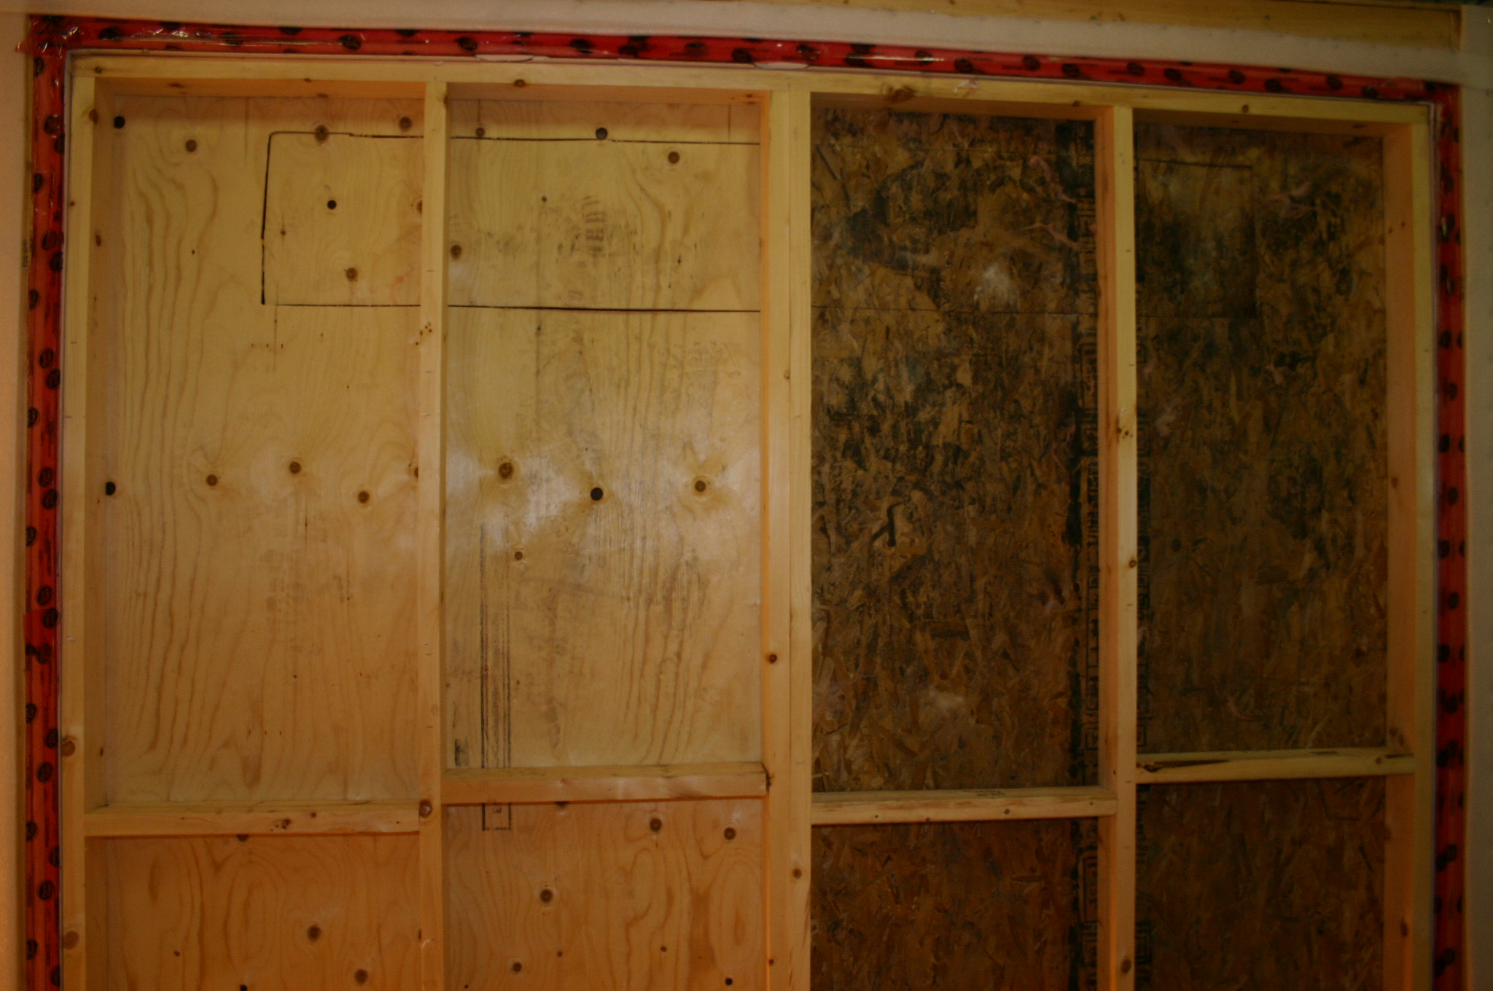

Slide 29
Airtightness

Slide 30
Typical 5 ach@50
Getting rid of big holes 3 ach@50
Getting rid of smaller holes 1.5 ach@50
Getting Passive 1.0 ach@50

Slide 33
Ventilation Rates

Slide 34
Dilution Is Not The Solution To Indoor Pollution
Source Control

Slide 35
Dilution For People
Source Control For The Building

Slide 36
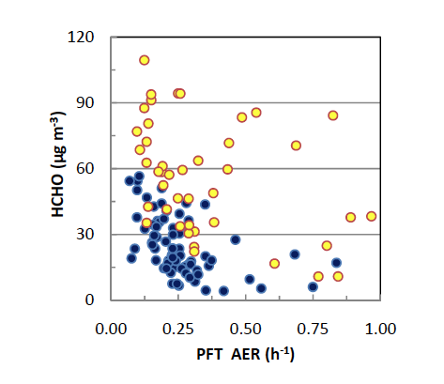
Aubin, D., Won, D.Y., Schleibinger, H., 2010

Slide 37
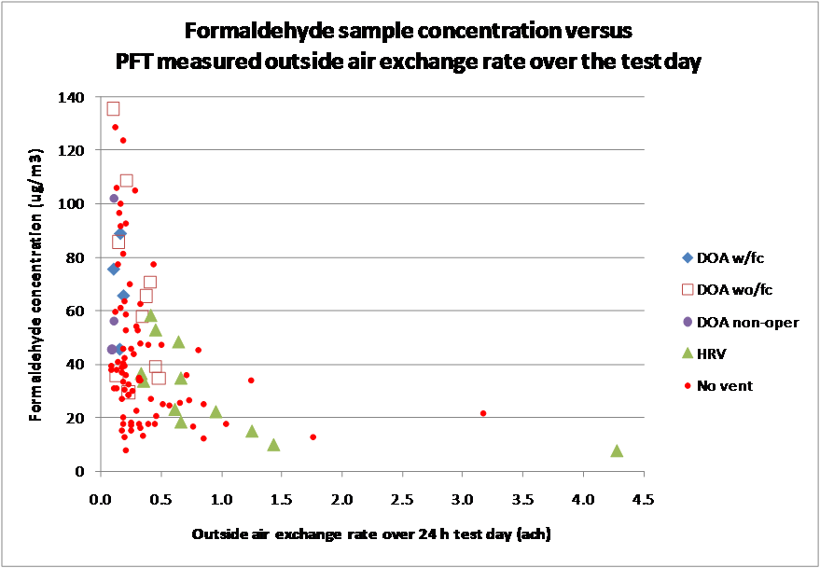

Slide 38
Pressures

Slide 39
Kitchen Exhaust Hoods

Slide 52
Clothes Dryers

Slide 55
Fireplaces

Slide 60
Relative Humidty

Slide 61
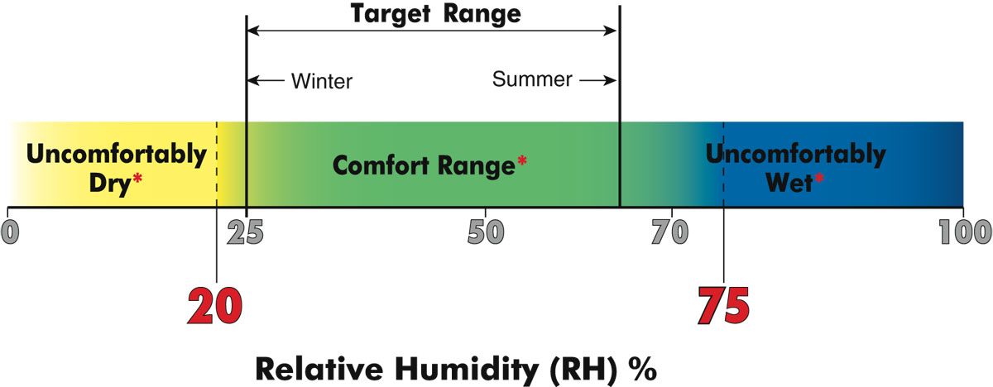

Slide 62
Recommended Range of Relative Humidity
Above 40 percent during winter
Below 60 percent during summer

Slide 66
Net Zero Buildings…..

Slide 67
Net Zero Buildings…..
75 percent conservation
25 percent renewables

Slide 69
Conservation
5 – 10 – 20 – 40 – 60 – 1.5
Windows, Slab, Crawl/Basement, Wall, Roof
1.5 ach@50 with ERV

Slide 70
Renewables – IECC 2 and 3
2,500 ft2 home - 7.5 kw PV

Slide 71
Conservation – IECC 2 and 3
5 – 10 – 20 – 40 – 60 – 1.5
Windows, Slab, Crawl/Basement, Wall, Roof
1.5 ach@50 with ERV
….Distributed Thermal Mass….

Slide 75
Light and Tight…..
beat
Mass and Glass….
But….
the time constant now matters

Slide 76
Conservation – IECC 2 and 3
5 – 10 – 20 – 40 – 60 – 1.5
Windows, Slab, Crawl/Basement, Wall, Roof
1.5 ach@50 with ERV
….Distributed Thermal Mass….
….Plus a Ford F-150 electric….

Slide 79
