Slide 1
Building Science
Joseph Lstiburek, Ph.D., P.Eng, ASHRAE Fellow
Adventures In Building Science
www.buildingscience.com

Slide 2
Correction….

Slide 3
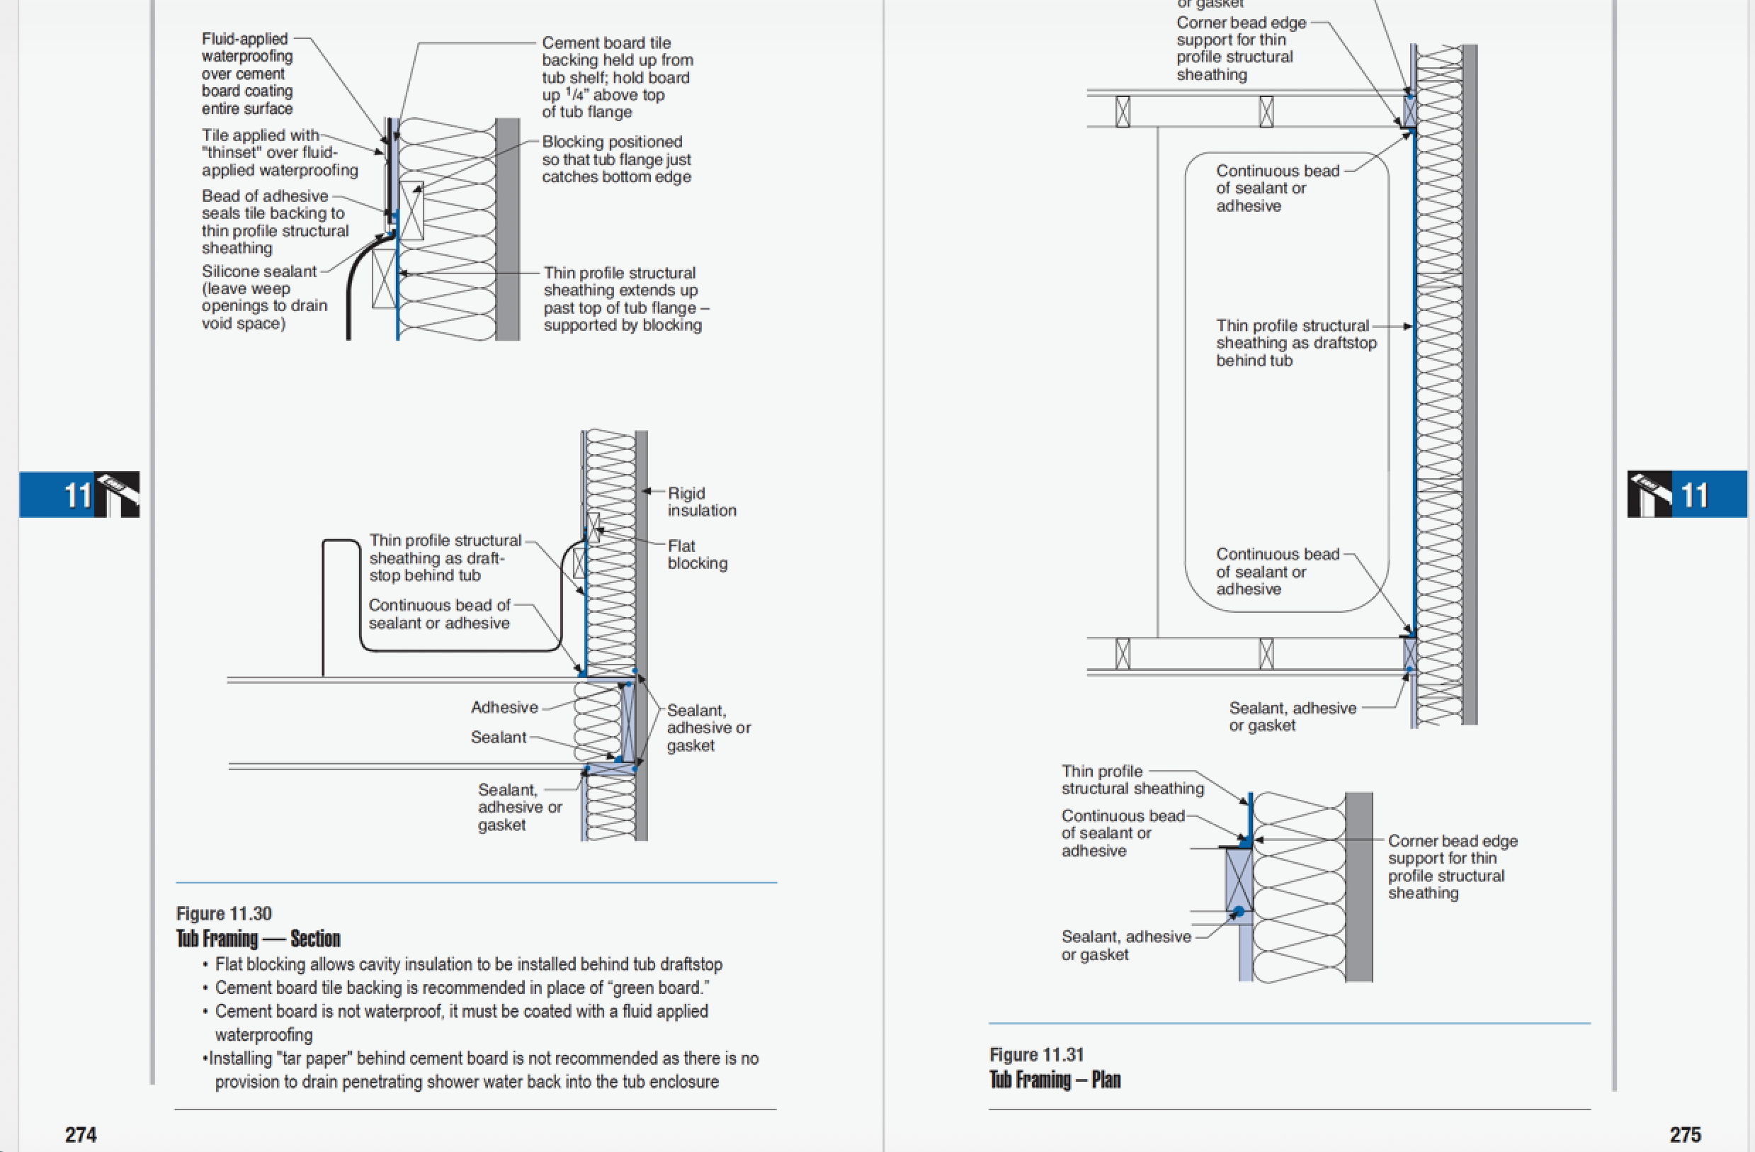

Slide 4
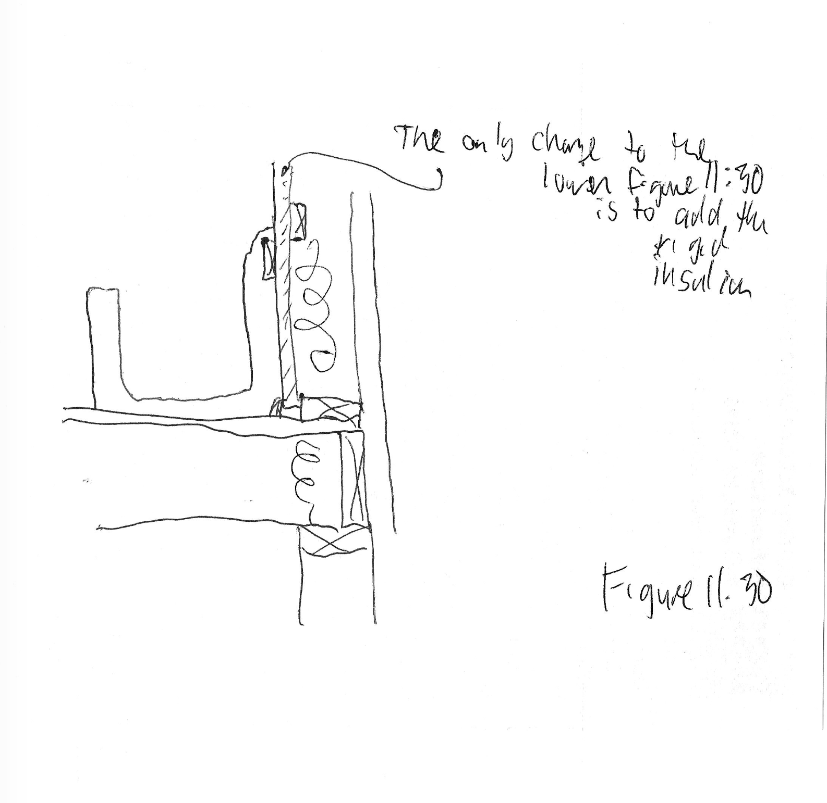

Slide 5
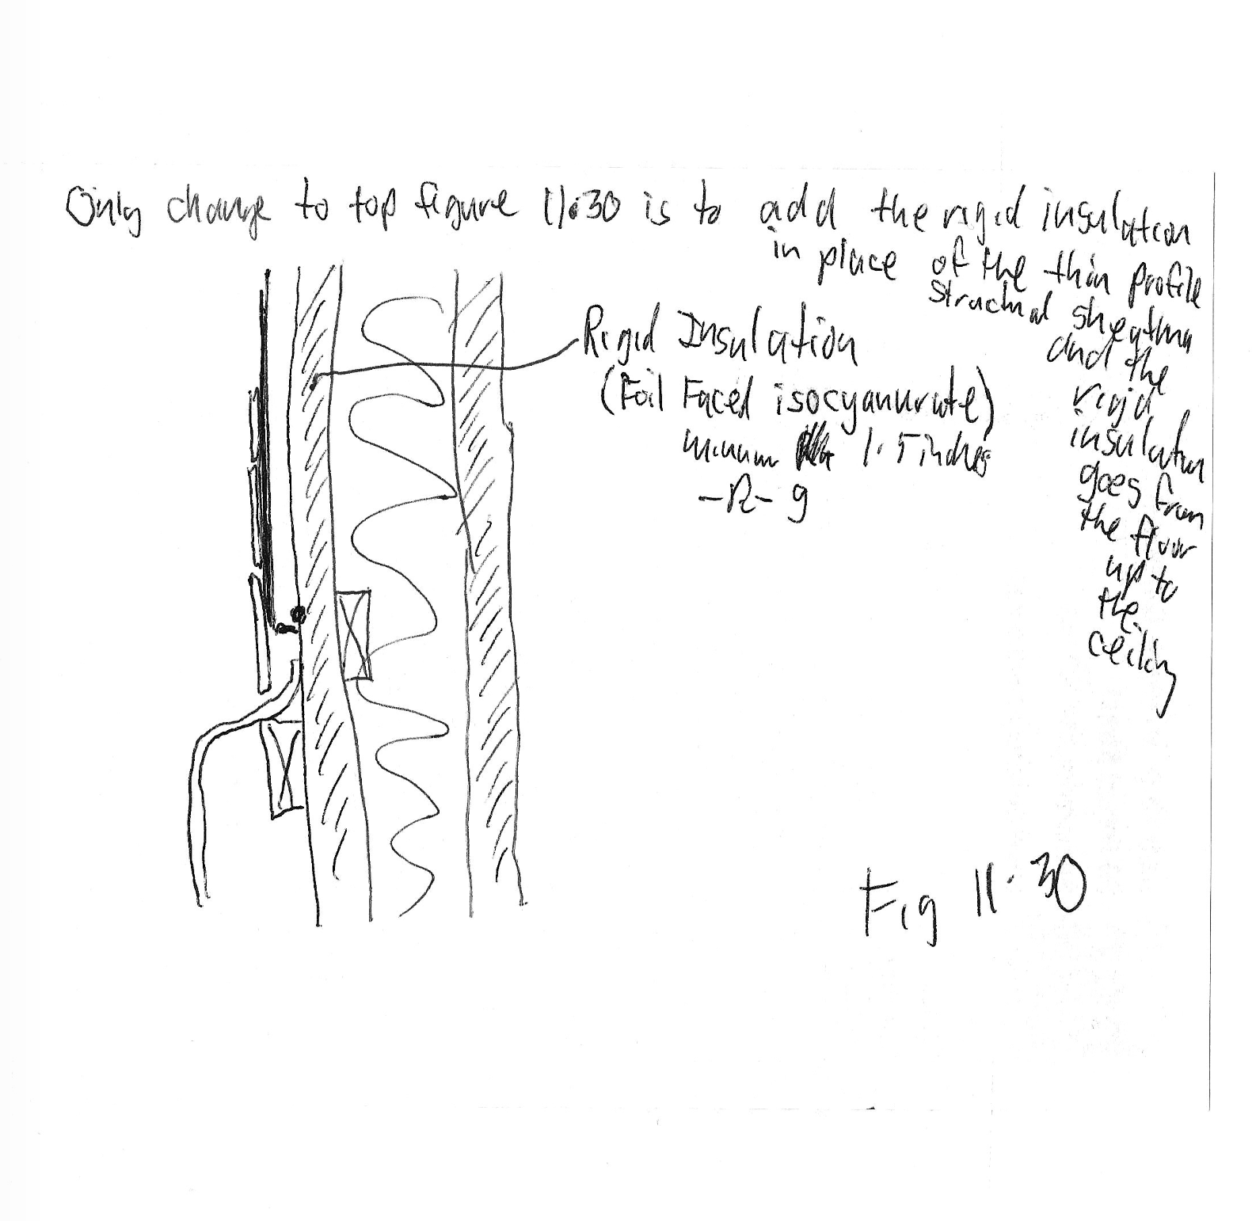

Slide 6
